Slide 1


AUTOGLUON – GET ON THE AUTOML-WAGON
28TH APRIL 2022

Slide 2

WELCOME
‘Dayo Oguntoyinbo, Senior Data Scientist
Amazon Web Services
MSc. (Aalto University)

Slide 3








APPROACH
TALK
DEMO
ASK
12
minutes
10
minutes
8
minutes

Slide 4

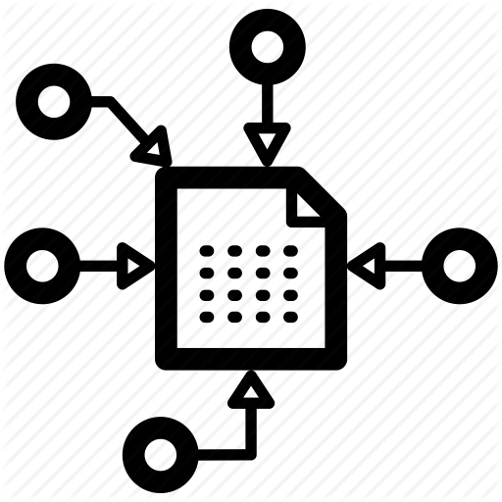



CONTENT
WHY
WHAT
HOW
THEN
ASK
…do we need AutoML?
…really is AutoGluon?
…does AutoGluon work?
…a quick deep dive
…and let’s discuss

Slide 5
WHY
Why do we need AutoML?
According to Analytics Vidhya, AutoML “… aims to automate all time-consuming operations like the selection of algorithms, writing the code, pipeline development, and hyperparameter tuning” and “…speedily resolving the business challenges at hand”.
We can say that AutoML allows quick automation of the fundamental building component of an entire Machine Learning pipeline by have an almost none or limited human intervention.
Consider your typical Machine Learning process, collect the data, prepare the data, maybe features engineering, select the algorithm, train the model, evaluate the model, tune or optimise the model parameter, make prediction and/or perhaps interpret the model.
All these could take time in the grand scheme of things
In short, AutoML allows for Quick fail-fast approach, Speedy experimentation, Efficient prototyping, Express novice onboarding, you add more.

Slide 6
WHY
In 2017 blog, Google CEO Sundar Pichai wrote, “…designing neural nets is extremely time intensive, and requires an expertise that limits its use to a smaller community of scientists and engineers. That’s why we’ve created an approach called AutoML, showing that it’s possible for neural nets to design neural nets. We hope AutoML will take an ability that a few PhDs have today and will make it possible in three to five years for hundreds of thousands of developers to design new neural nets for their particular needs...”
And Amazon announced its own release of AutoML to serve as the new toolkit that helps to simplify “the creation of deep learning models with just a few lines of code…” That release marks Amazon’s entrance in the ultra-competitive Automated machine learning (AutoML) space. And AutoGluon was born.
Some examples of Open-source AutoML are H2O AutoML, AutoKeras, AutoPytorch, Azure ML, and so on.

Slide 7
WHAT
What is really AutoGluon? auto.gluon.ai
According the official web page, AutoGluon enables easy-to-use and easy-to-extend AutoML with a focus on automated stack ensembling, deep learning, and real-world applications spanning image, text, and tabular data
So have you ever thought of:
Making a quick deep learning prototype deep learning and creating classical ML solutions;
Desired to automatically utilize state-of-the-art techniques without expert knowledge;
Thinking of leveraging automatic hyperparameter tuning, model selection, ensembling and data processing;
Easily improving or tuning your bespoke models and data pipelines?
AutoGluon AutoML can be used for Tabular, Image, Text Predictions and Object Detection, for Tabular, Image and Text Data alike.

Slide 8
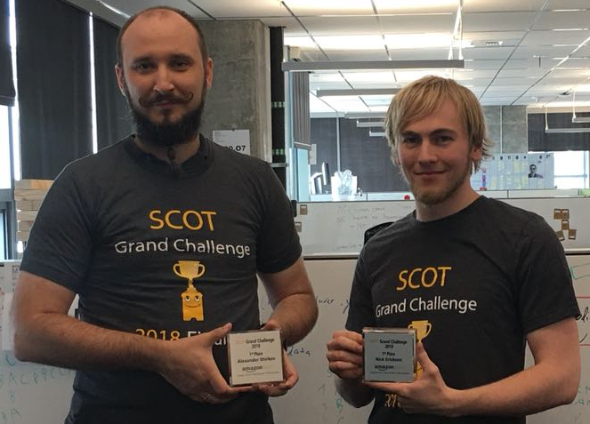
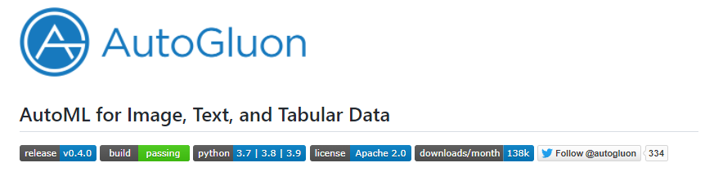
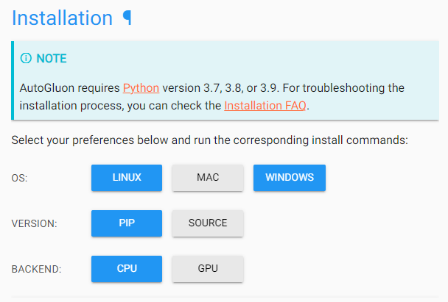
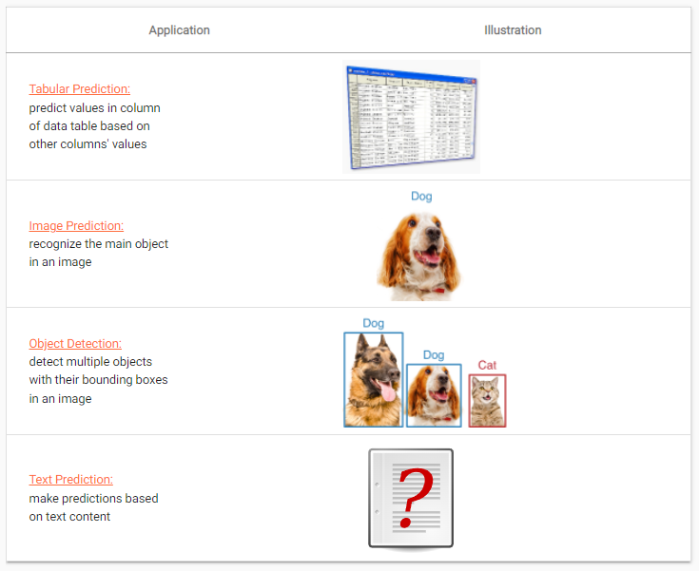
WHAT
Origin of AutoGluon
Nick Erickson
Alex Shrikov
Fully Open-source
https://github.com/awslabs/autogluon
Installation Ease
Impeccably detail
documentation & tutorials
https://auto.gluon.ai/

Slide 9
HOW
How does AutoGluon works?
We will not go into the core of the AutoGluon Framework, but I will leave us with the paper released on one of AutoGluon approaches by Erickson N. et al, titled – “AutoGluon-Tabular: Robust and Accurate AutoML for Structured Data” https://arxiv.org/abs/2003.06505.

Slide 10
HOW
AutoGluon has a large number of models implemented and these models are optimized out of the box:
Powerful Gradient Boosting Models, XGBoost, LightGBM, CatBoost
Custom Tabular Neural Networks
Scikit-learn Random Forest, Extra Trees, KNN
SOTA Image Models: EfficientNet, ResNet, et cetera
SOTA Text Models: BERT, Electra and newly introduced HuggingFace Compatible Model!

Slide 11
HOW
Before we deep dive, here is an AutoGluon Cheatsheet to get us started with.

Slide 12
THEN
Let’s have a quick dive.
AWS – Sagemaker Notebook
You can certainly use your preferred. But a caveat for Windows users, there is currently capability for Tabular Prediction.
https://github.com/awslabs/autogluon/blob/master/examples

Slide 13

ASK

Slide 14
THANK YOU FOR LISTENING

Slide 15
REFERENCES
AutoGluon AutoML - https://auto.gluon.ai/
AutoGluon AWSLAB Page - https://github.com/awslabs/autogluon
AutoGluon Cheatsheet - https://auto.gluon.ai/stable/autogluon-cheat-sheet.pdf
Analytics Vidhya, Beginner’s Guide to AutoML with an Easy AutoGluon Example (analyticsvidhya.com)
Getting Started with AutoML, Getting Started with AutoML and AWS AutoGluon | by Philipp Schmid | Towards Data Science
Making AI work for everyone, Sundar Pichai. Making AI work for everyone (blog.google)
Amazon Science - Amazon’s AutoGluon helps developers deploy deep learning models with just a few lines of code. Amazon’s AutoGluon helps developers deploy deep learning models with just a few lines of code - Amazon Science
H2O AutoML
AutoKeras
AutoPytorch
Azure ML

